Slide 1

Scrum-Agile Approach
Presentation by: Brianna McCollum

Slide 2
Scrum-Agile Team Roles
Product Owner
Interacts with Stakeholders and Users
Directs work through making User Stories and maintaining Product Backlog
Scrum Master
Pseudo-leader of the group, helping the Developers when needed
Runs Scrum activities like the Daily Scrum
Developer
Creates code based on User Stories
Must be Independently motivated and work with team to keep up with Sprints
Tester
Develops test cases based on User Stories
Tests throughout the development process, not after

Slide 3
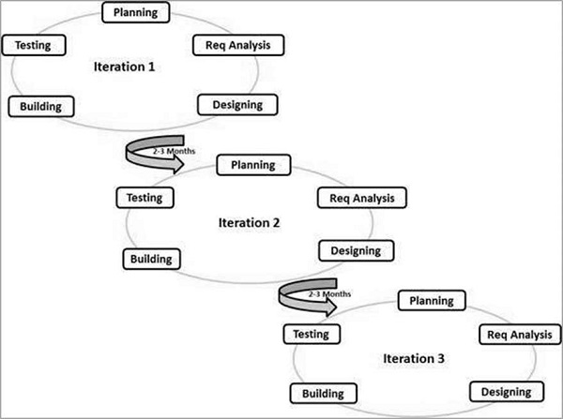
Agile Approach
Complex, iterative approach to software development
Steps are done in “Sprints,” repeating blocks of work done in predefined time periods
Less preplanning than Waterfall, uncertainties are ironed out throughout the Sprints
Image source: https://www.tutorialspoint.com/sdlc/sdlc_agile_model.htm

Slide 4
Agile Steps
Plan
Before work on a sprint begins, planning must take place
In Agile, this involves a lot of estimation, as much is left up to change to keep adaptability
This is also where system requirements are decided, but again, that may change later into the sprint
Design
The Product Manager collects User Stories from potential customers
These stories are then used to complete the Product Backlog and Scrum boards, which will guide the build process
Initial stakeholder input is also considered, but may be changed later
Build
The physical development of the product by Developers in the team
Packageable, functioning results are shown to stakeholders and other important groups as work is done
The Scrum Board and Product Backlog will be updated dynamically as work is achieved
Test
Functional code is run through test cases designed after the User Stories to ensure they’re being met
Testing is often done side by side with building, to ensure quality work
Testing will also take place afterwards, before the product ships to market

Slide 5
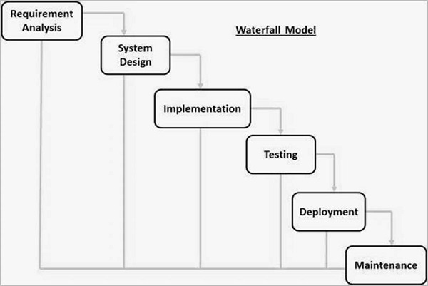
Waterfall Approach
Simple, linear approach to software development
Steps are done in sequential order, “flowing” into one another.
Large amount of preplanning and preparation work
Image source: https://www.tutorialspoint.com/sdlc/sdlc_waterfall_model.htm

Slide 6
Waterfall vs Agile
Waterfall
Pros
Simple. Easy to understand and follow
Cons
Incredibly rigid and dependent on planning
Agile
Pros
Flexible and Adaptable, can change course at any point
Cons
Complex. Takes training and dedication to follow
Preplanning leaves little uncertainty and firm deadlines
Prone to bugs due to testing at the end of the process
Self-Organizing teams allows for more free-form programming
Responds to changes in market or technology restraints quickly
Struggles to respond to market demand changes
A constant work cadence with high expectations. Can cause burnout
Lack of preplanning and clear roles may lead to team members feeling lost
Roles are set clearly from the beginning and leave less room for misunderstanding

Slide 7
Why we chose Agile
The SNHU Travel project benefitted from Agile for several different reasons:
Agile provided us with a strong production cadence to keep up with the fast-paced development
Flexibility allowed us to adapt to stakeholder requests
In Waterfall, we would not have been able to switch to focus on wellness-based travel locations, which would have harmed the product’s success.
Communication with users and developing off User Stories made the product connect better with target audiences
Dynamic peer testing reduced the number of bugs in our code by a considerable margin
Waterfall places testing at the very end, and can often lead to a buggy product being released due to unforeseen circumstances or a lack of time

Slide 8
But Waterfall is still valid
Waterfall is a perfectly fine model to choose for projects that involve:
A clearly defined plan with firm deadlines
Unchanging requirements from stakeholders and industry
Little to no uncertainty
A longer-term scope with large stretches of work
While Agile worked great, Waterfall would have also worked for SNHU Travel
Flexibility and audience communication would have been exchanged for clearer deadlines, better planning and an easier experience on the team
Defaulting to a single framework for all projects is silly. Pros and cons should be evaluated on a project-by-project basis.
Hybridizing the best parts of certain framework is also valid, but would require proper company training to accomplish

Slide 9
Works Cited
Cobb, Charles G. The Project Manager’s Guide to Mastering Agile : Principles and Practices for an Adaptive Approach. Hoboken, New Jersey, John Wiley, 2015.
Leather, E. (2017, April 7). Amazonian Agility. Frontira | Product Insights. https://medium.com/frontira/amazonian-agility-e3720ff004f7
“SDLC Tutorial - Tutorialspoint.” Tutorialspoint.com, 2019, www.tutorialspoint.com/sdlc/index.htm.

